Slide 1
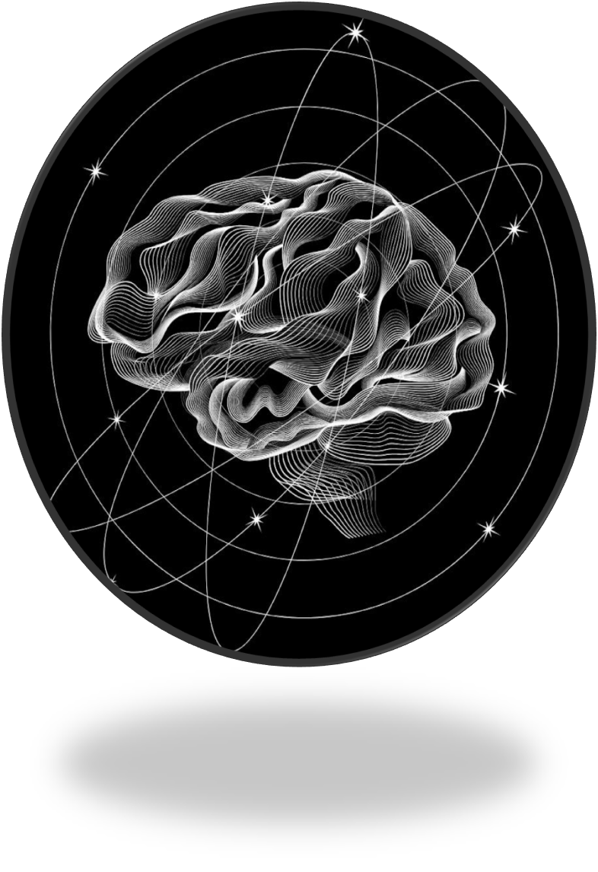
Quester
Adaptive AI Learning Ecosystem
"A living AI learner that grows with you — not for you."
GenAI Hackathon 2025 • Theme: EduTech
Credible Create | Anshuman | Shashank Mishra

Slide 2

Problem Statement The Learning Crisis We Face Today
One-Size-Fits-All Approach
Content Overload Paralysis
Traditional platforms force rigid pathways that ignore individual cognitive patterns and learning styles.
Learners drown in endless resources with no intelligent guidance on skill level or learning preferences.
Static AI That Can't Evolve
Current AI tutors lack memory and adaptation — restarting every session, never understanding how you learn.

Slide 3
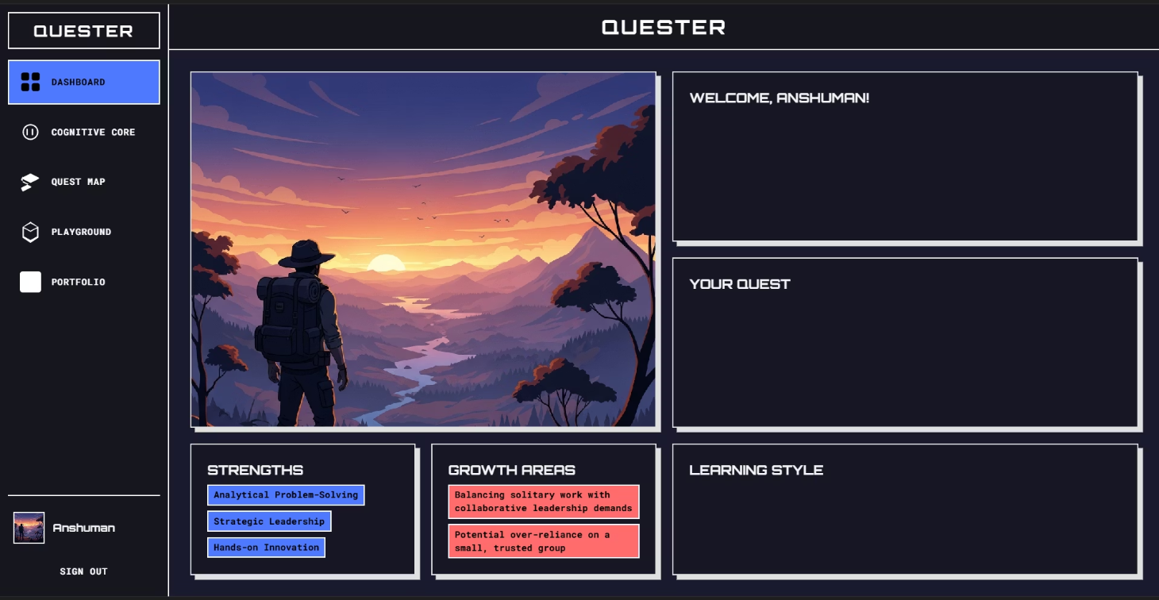
Proposed Solution Our Vision
We reimagine learning as a living system that adapts to your mind — in real time.
Quester creates a living learning ecosystem that mirrors each user's cognitive behavior and adapts dynamically.
It transforms education from static content consumption to adaptive cognitive evolution.

Slide 4

Built on Cutting-Edge Technology
Frontend & Visualization
Backend & Intelligence
React — Dynamic, responsive user interfaces
Node.js — Scalable API architecture
React flow — Interactive skill genome visualizations
Gemini AI — Natural language understanding
TailwindCSS — Modern, futuristic design system
supabase — Real-time data synchronization

Slide 5
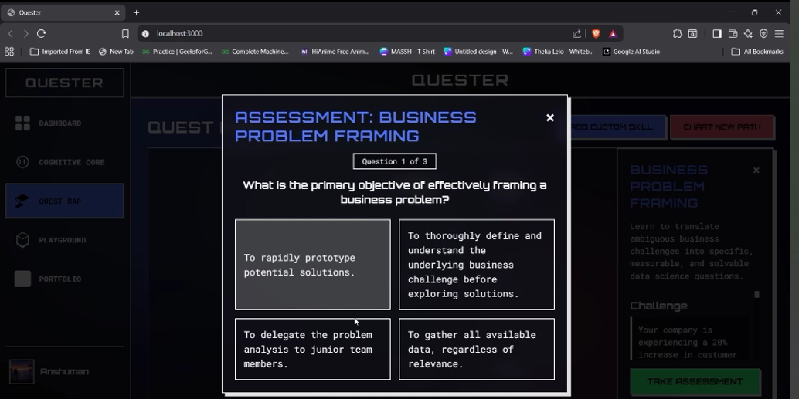
Prototype Ready
Learn. Evolve. Repeat.
Let's redefine learning together!

Slide 6







Solution Overview The Cognitive Quest Learning Loop
Skill Genome
Dynamic visualization tracks skill development, confidence levels, and knowledge gaps over time.
Cognitive Mirror
AI analyzes learning patterns, preferences, and cognitive strengths through continuous interaction.
Project Playground
Intelligent recommendations connect learners with precisely matched resources and learning experiences.
This continuous cycle ensures the system evolves alongside each learner, creating increasingly personalized experiences with every interaction.

Slide 7






Powerful Features Built for Intelligence
Adaptive Learning Paths
Skill Genome Visualization
Dynamic curriculum adjusts difficulty, pacing, and content type based on real-time performance and engagement data.
Interactive knowledge maps reveal connections between skills, highlight growth areas, and track mastery levels.
Gemini AI Integration
Confidence Scoring
Powered by Google's advanced AI for natural language processing, content curation, and intelligent recommendations.
Measures not just what you know, but how confident you are — addressing imposter syndrome and knowledge gaps.
Cognitive Avatar
Collaborative Intelligence
Your personal AI learning companion remembers your journey, celebrates wins, and provides contextual guidance.
Learn from peer patterns while maintaining privacy — the system improves from collective learning behaviors.

Slide 8
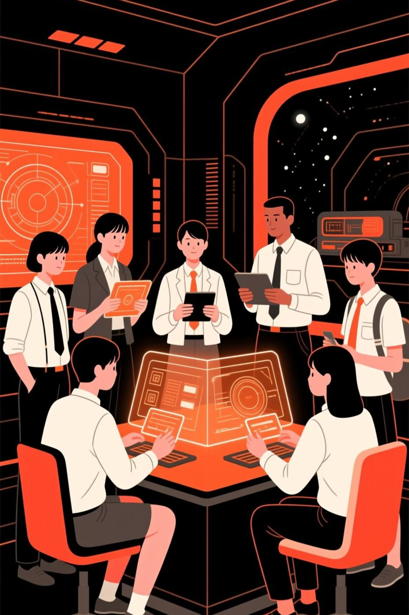
Targeted Audience Designed for Every Learning Journey
1
Students
Personalized learning paths that adapt to individual pace, style, and cognitive strengths for better comprehension.
2
Educators
AI-powered insights into student learning patterns enable targeted interventions and curriculum optimization.
3
Corporate Teams
Scalable upskilling programs that track skill development and adapt training to workforce needs in real-time.
4
EdTech Platforms
Integration-ready cognitive layer that transforms static content delivery into dynamic, adaptive experiences.

Slide 9
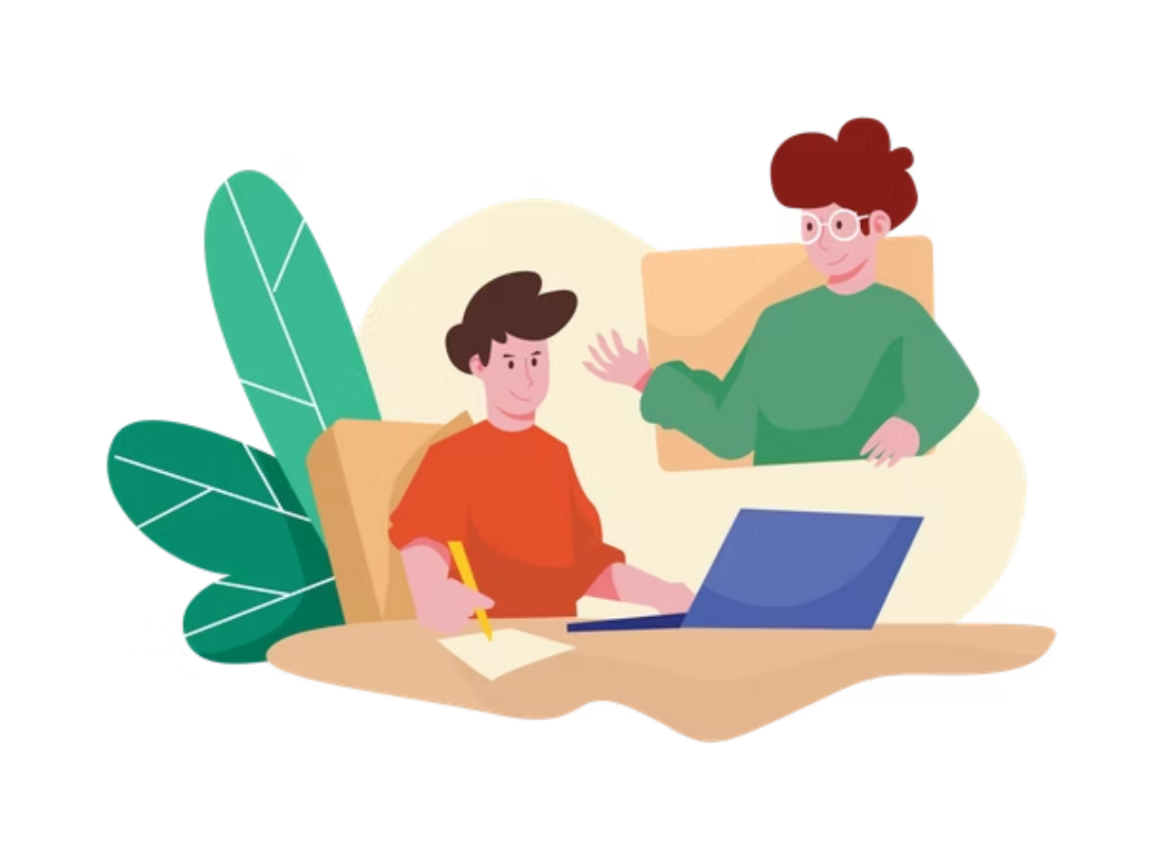
Measurable Impact on Learning Outcomes
3.5x
2.2x
Higher Engagement
Faster Skill Mastery
Personalized pathways keep learners actively participating versus passive consumption
Adaptive difficulty prevents frustration and boredom — the top reasons learners quit
"Cognitive Quest creates personalized learning that adapts like a human brain — scalable, measurable, and cognitive by design."

Slide 10
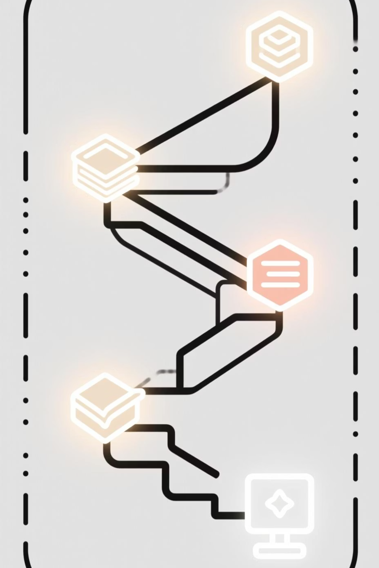
Credible Create
Team members
Anshuman Shukla
Shashank Mishra
Thankyou

